Slide 1

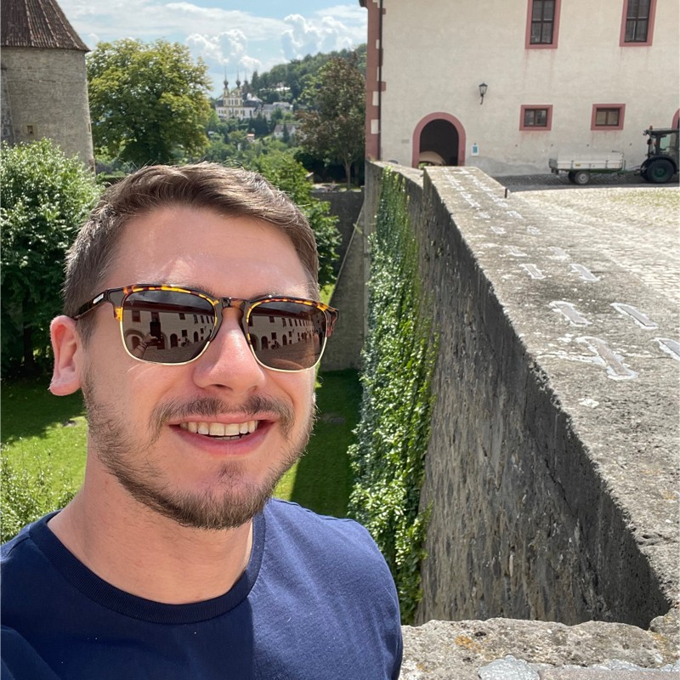
Cyberwarfare: Novel Wipers used in Ukraine 2022
Ashu Sharma
Ryan Estes

Slide 2
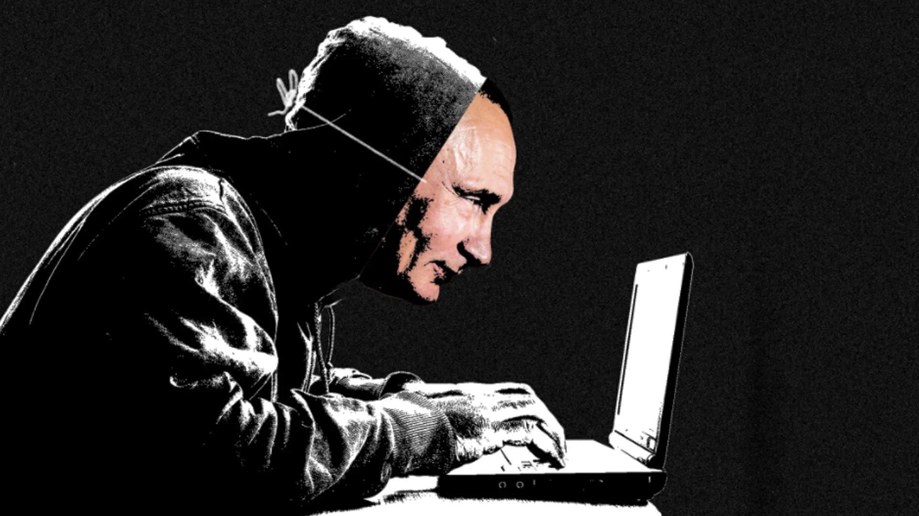

Agenda
Introduction
How It Started
What is Cyberwarfare?
Threat Landscape
A New Battlefield
The Russian/Ukraine Conflict
Threat Actors
Major Malware involved
Cyberwarfare Timeline
Technical Analysis
ISAACWiper (Ryan)
Azov Ransomware (Ashu)
Threat Hunting
YARA Rules
VirusTotal Query (Azov)
Sample Hashes
Q&A
References

Slide 3
Introduction

Slide 4
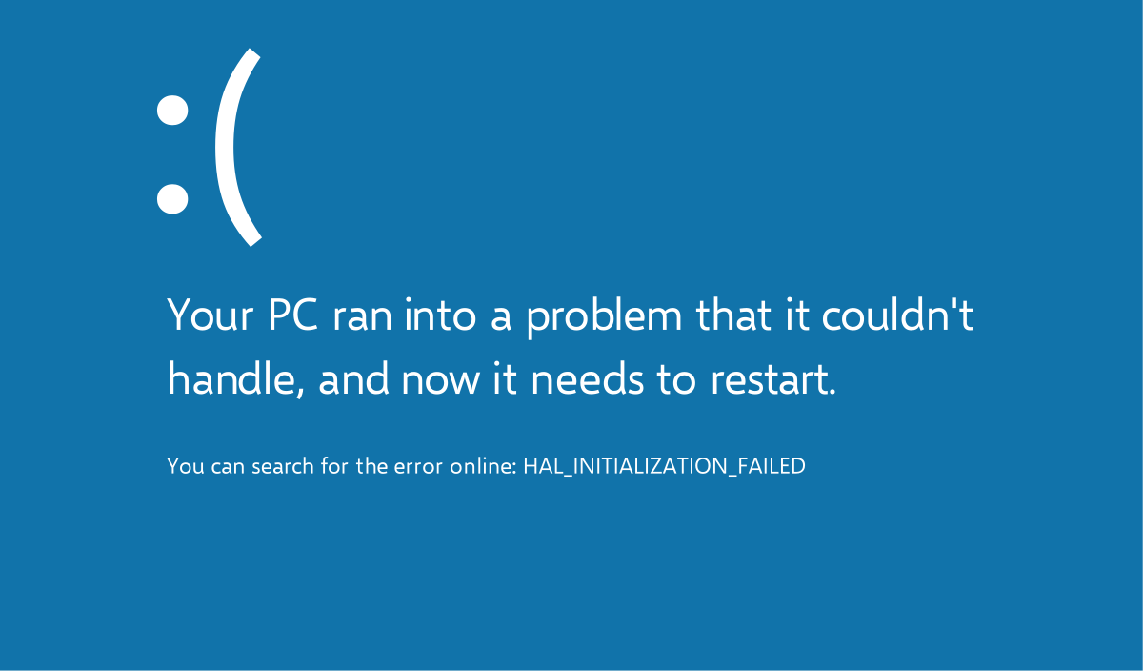
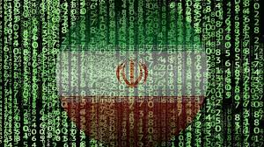
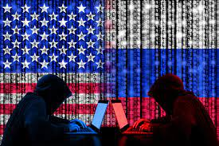
The Beginnings of Cyberwarfare
A customer in Iran reported arbitrary BSODs and computer reboots and responded with a Windows OS misconfiguration.
Observed persistence.
58% of devices in Iran were infected, and nobody knew what the purpose of the code was.
Highly skilled hackers used zero-day vulnerabilities.
Notes:
The Man Who Found Stuxnet – Sergey Ulasen
Blue screen of death
#https://www.youtube.com/watch?v=U_7CGl6VWaQ
#https://eugene.kaspersky.com/2011/11/02/the-man-who-found-stuxnet-sergey-ulasen-in-the-spotlight/
#https://www.wilderssecurity.com/threads/rootkit-tmphider.276994/#post-1712134

Slide 5
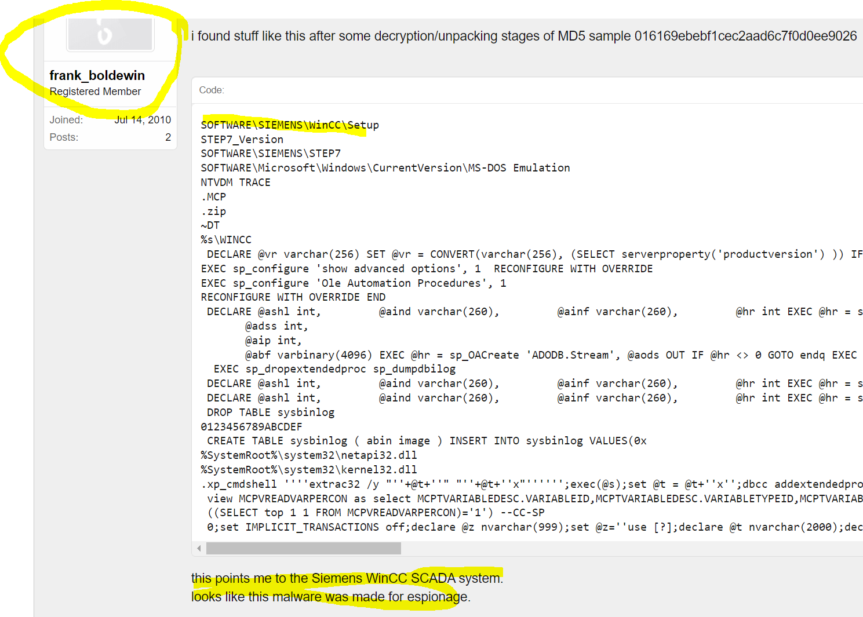
The Beginnings of Cyberwarfare

Slide 6
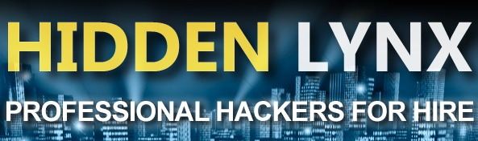

The Beginnings of Cyberwarfare
The Stuxnet drivers were signed with genuine digital certificates from respected companies.
Said it was an option.
And then Estates comes into business.
Detections were delayed.
Pay to exploit hackers; buy exploits and keep zero days.
Notes:
The Man Who Found Stuxnet – Sergey Ulasen

Slide 7
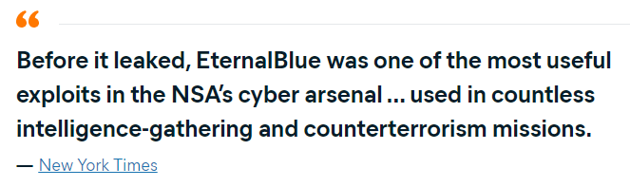
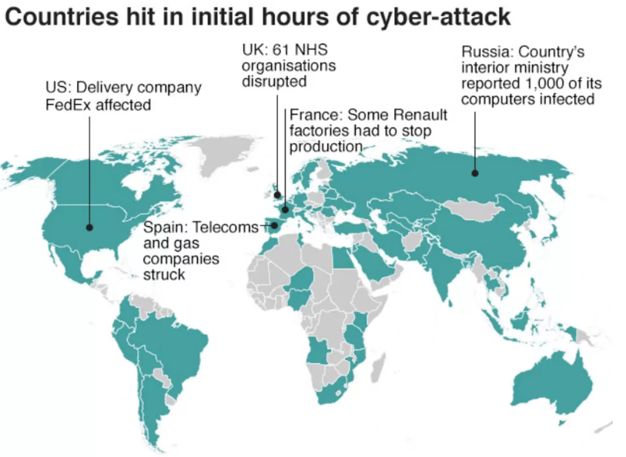
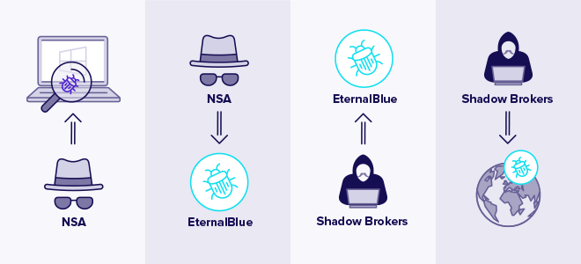
Game of Exploits

Slide 8
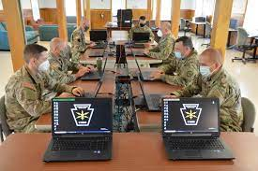
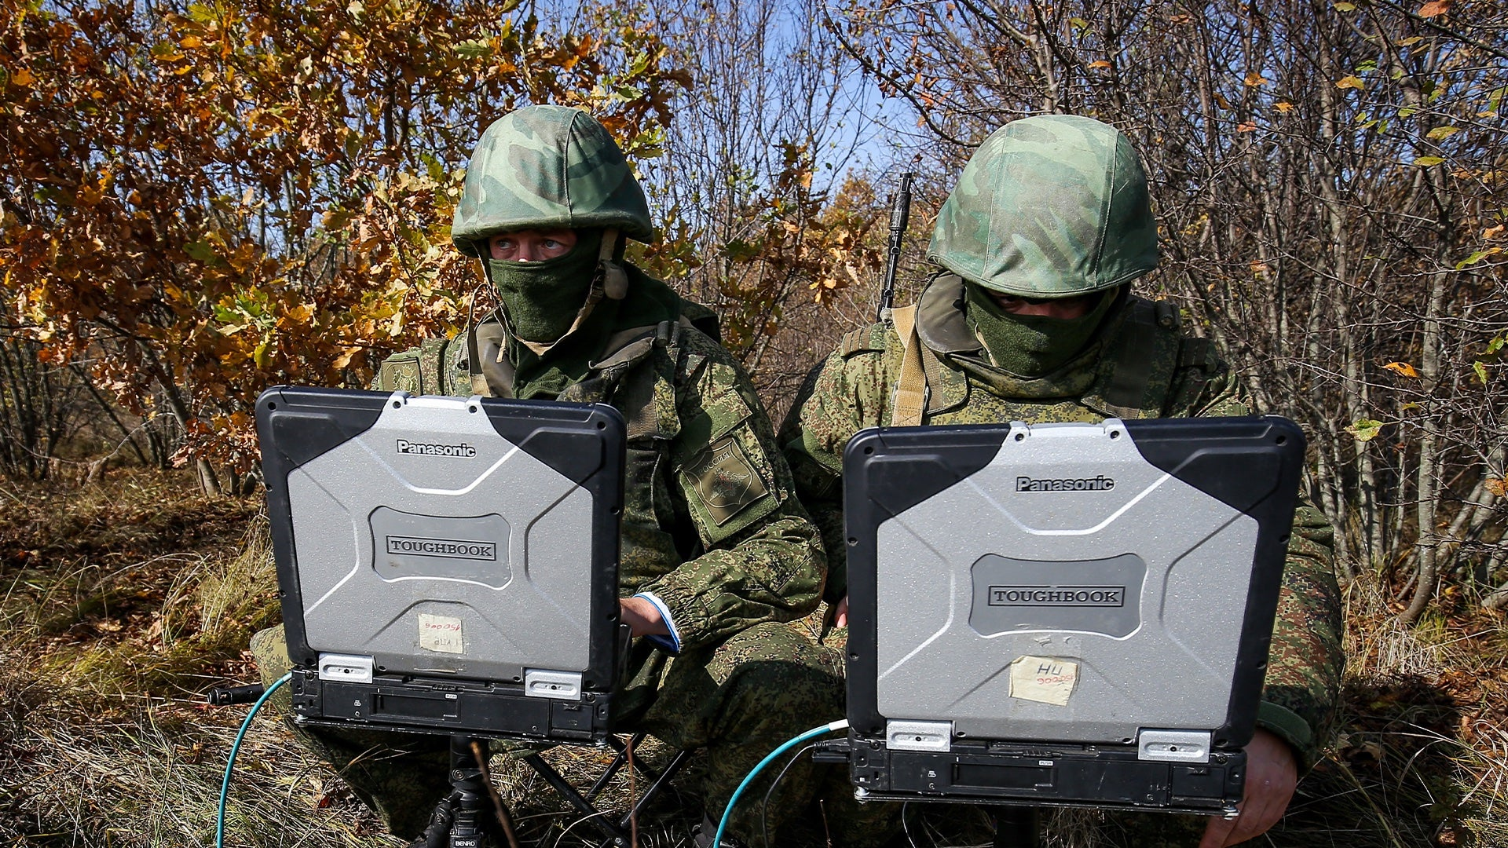
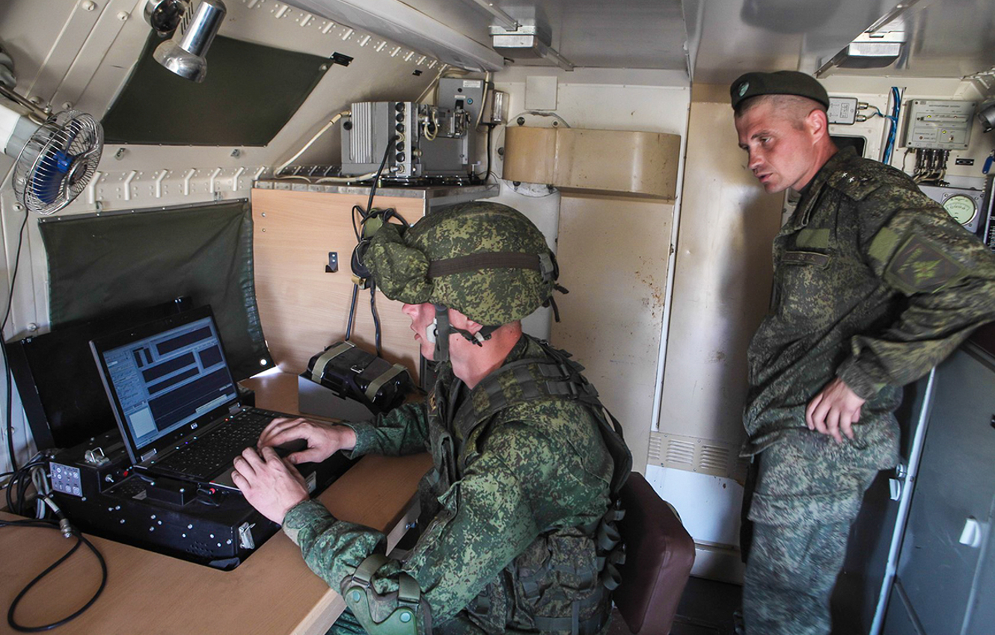
A New Battlefield
#https//www.imperva.com/learn/application-security/cyber-warfare/#~text=Cyber%20warfare%20is%20usually%20defined,and%20even%20loss%20of%20life.

Slide 9
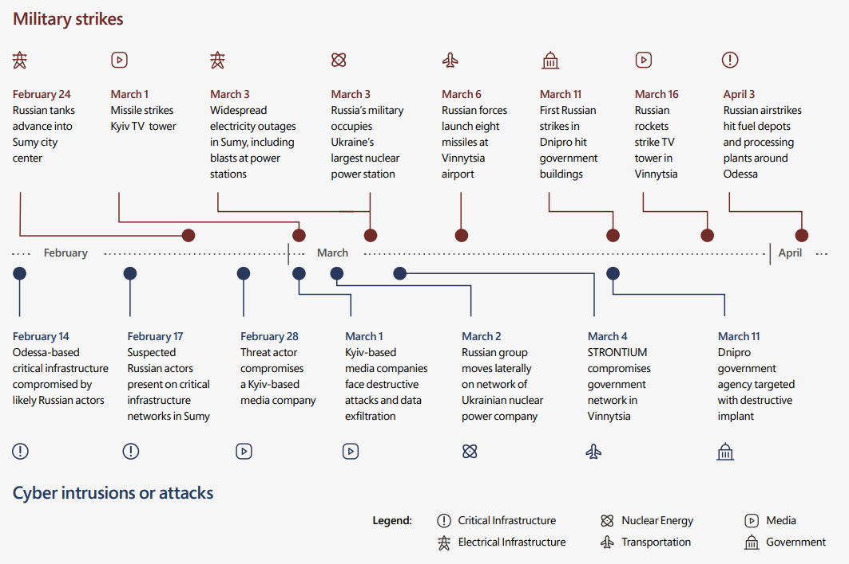
Early Attacks in the Conflict
https//query.prod.cms.rt.microsoft.com/cms/api/am/binary/RE4Vwwd

Slide 10
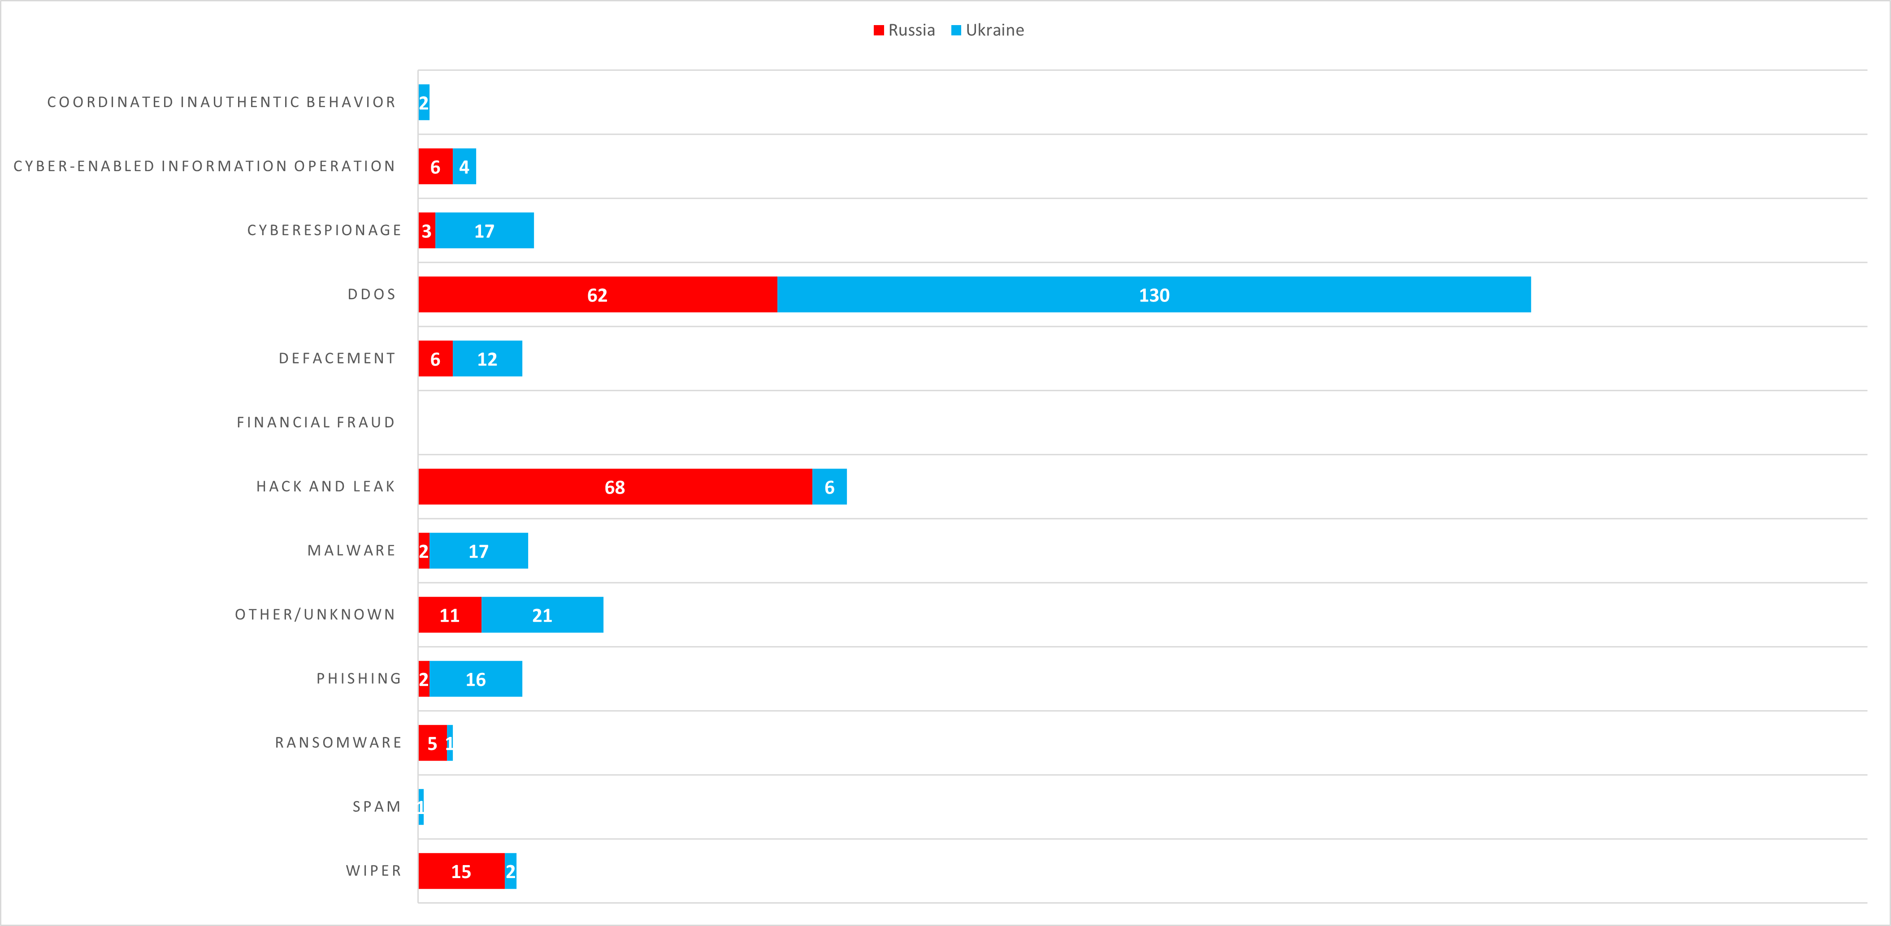
Cyberwarfare Attack Types

Slide 11
Threat Actors

Slide 12
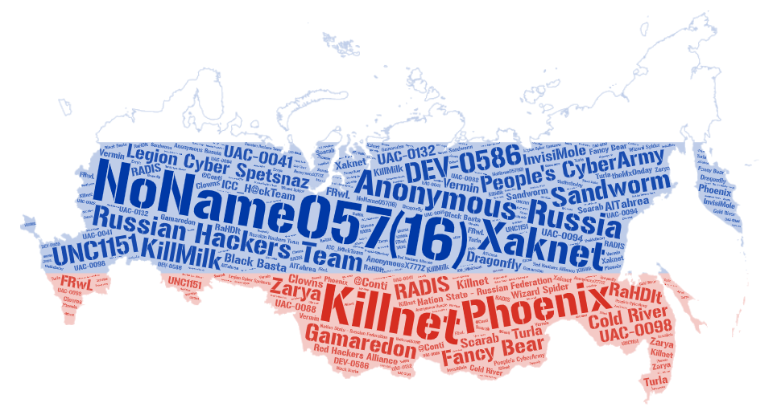
Threat Actors (Russia)
Allegiance to Russia
Name | Type | Country | Attacks
NoName057(16) | Collective | Russia | 171
Anonymous Russia | Nation State | Russia | 100
Killnet | Collective | Russia | 85
People's CyberArmy | Collective | Russia | 64
Russian Hackers Team | Collective | Unknown | 19
Phoenix | Collective | Russia | 18
Sandworm | Nation State | Russia | 16
Xaknet | Individual | Russia | 14
DEV-0586 | Collective | Russia | 10
Legion Cyber Spetsnaz | Collective | Russia | 8
Fancy Bear | Collective | Russia | 8
UNC1151 | Collective | Belarus | 7
Gamaredon | Collective | Russia | 6
Nation State - Russian Federation | Collective | Russia | 5
Cold River | Collective | Russia | 3
KillMilk | Collective | Russia | 3
RADIS | Cybercriminal | Unknown | 3
UAC-0098 | Unknown | Russia | 2
UAC-0041 | Collective | Russia | 2
Zarya | Collective | Russia | 2
ICC_H@ckTeam | Collective | Russia | 2
Many more … | Collective | … | …
Data derived from https://cyberconflicts.cyberpeaceinstitute.org

Slide 13
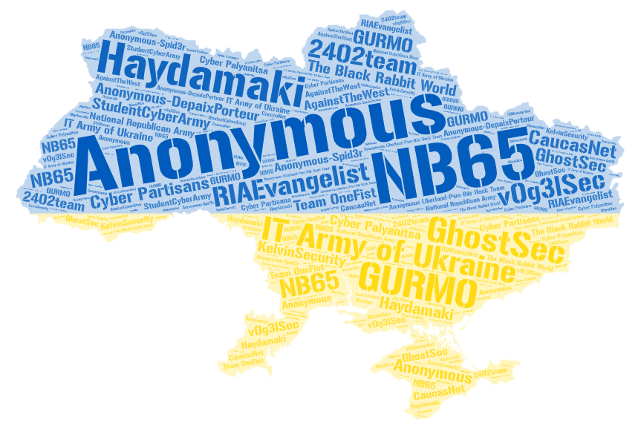
Threat Actors (Ukraine)
Allegiance to Ukraine
Name | Type | Country | Attacks
Anonymous | Collective | Unknown | 55
IT Army of Ukraine | Nation State | Ukraine | 39
NB65 | Collective | Unknown | 9
Haydamaki | Collective | Ukraine | 9
GhostSec | Collective | USA | 4
Anonymous-DepaixPorteur | Collective | Unknown | 3
GURMO | Nation State | Ukraine | 2
RIAEvangelist | Individual | USA | 2
The Black Rabbit World | Collective | Unknown | 2
StudentCyberArmy | Collective | Ukraine | 2
v0g3lSec | Collective | Unknown | 2
Cyber Partisans | Collective | Belarus | 2
2402team | Collective | Unknown | 1
Cyber Palyanitsa | Collective | Ukraine | 1
National Republican Army | Collective | Russia | 1
AgainstTheWest | Collective | Unknown | 1
KelvinSecurity | Cybercriminal | Unknown | 1
CaucasNet | Unknown | Unknown | 1
Team OneFist | Collective | Ukraine | 1
Anonymous-Spid3r | Collective | Unknown | 1
Anonymous Liberland-Pwn-Bär Hack Team | Collective | Unknown | 1
Data derived from https://cyberconflicts.cyberpeaceinstitute.org

Slide 14
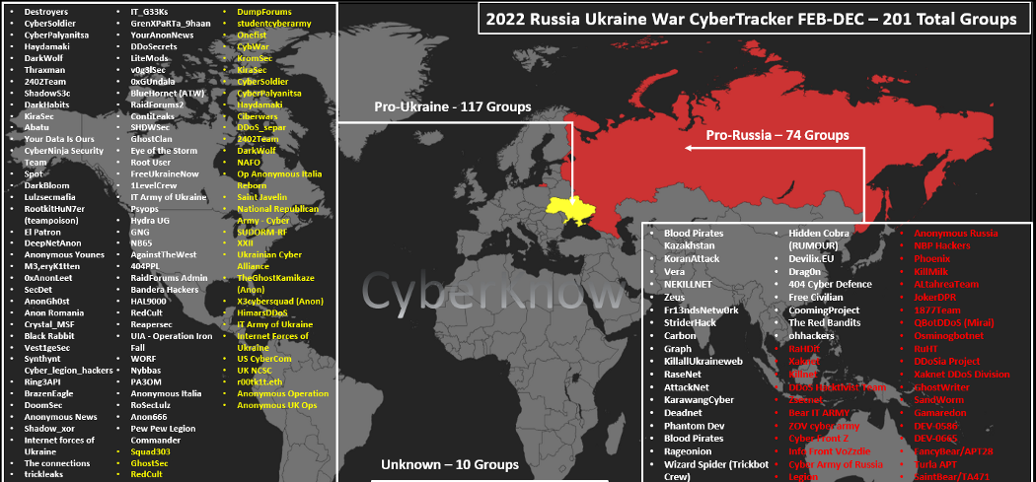
Threat Actors (CyberKnow)

Slide 15
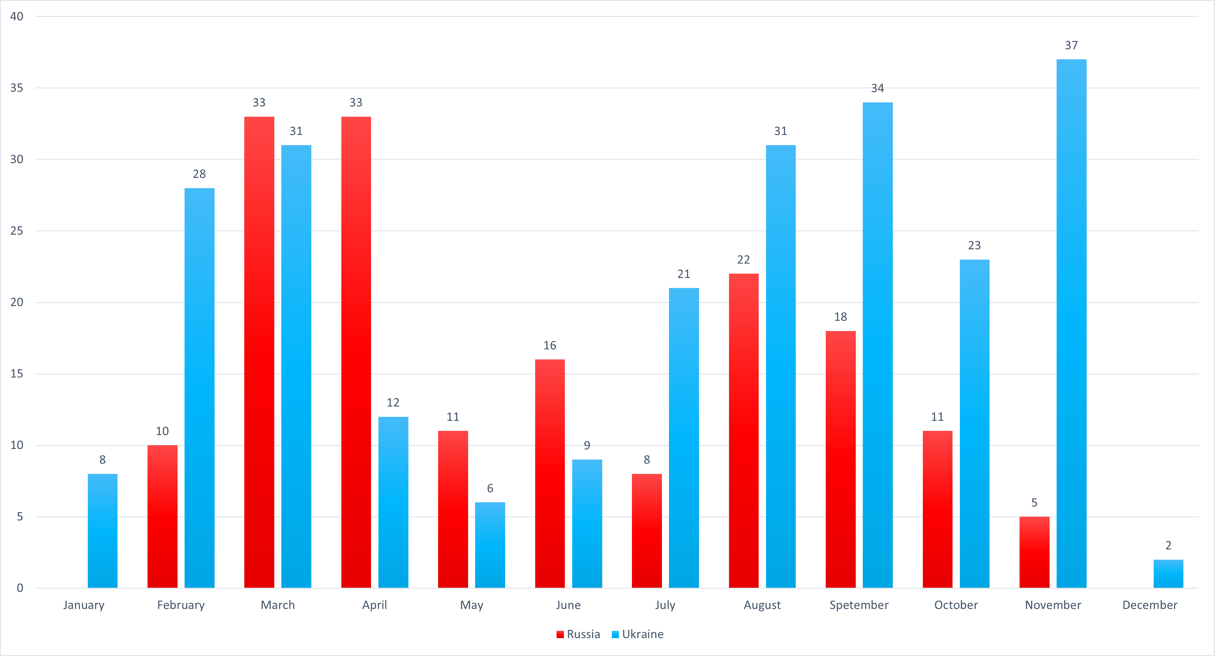
Reported Incidents by Month

Slide 16
UA/RU Novel Wipers Timeline

Slide 17
Timeline of Novel Wipers in Ukraine
WhisperGate
- The first novel wiper of the year
- Two-stage pseudo-ransomware
- Attributed to DEV-0586 (Russia)
- (JAN13) Also UNC1151 (Belarus)
DesertBlade
- Used in combination with missiles
- Targeted media company
- Attributed to unknown Russian threat actors
CaddyWiper
- Successfully used in multiple attacks (MAR14, APR1, APR8)
- Attacks Windows and Linux
- Attributed to Sandworm (Russia)
HermeticWiper HermeticWizard HermeticRansom
AcidRain
IsaacWiper
Official Start of Conflict
- Discovered the day before conflict
- targeted Viasat, disrupting comms
- UA, FR, DE, HU, GR, IT, PL
- Attributed to Russian Government
- First wiper preceding conflict
- Signed certificate “Hermetica”
- HermeticRansom == PartyTicket
- HermeticRansom used as decoy
- Attributed to Sandworm (Russia)
- Discovered alongside HW and AR
- Shares no code similarity to either
- Compilation as early as Oct2021
- Attributed to Sandworm (Russia)
- On the morning of February 24th, Putin announced a “special military operation” in Ukraine, marking the official beginning of the conflict.
FEB22
FEB23
FEB28
JAN12
FEB23
FEB24
MAR13

Slide 18
Timeline of Novel Wipers in Ukraine (cont.)
DoubleZero
- Two-stage wiper
- Each stage overrides with 0s
- Hence the name: “DoubleZero”
- Attributed to UAC-0088 (RU, BY)
Somnia Ransomware
- No known successful attacks
- pseudo-ransomware (wiper)
- Attributed to FRwL (Russia)
RansomBoggs
- Appears to be a “one and done.”
- crypto-ransomware
- Uses Monsters Inc. references
- No known samples discovered in wild
Industroyer2
ORCSHRED AWFULSHRED SOLOSHRED
Prestige Ransomware
Azov Ransomware
- ORCSHRED – Linux worm
- AWFULSHRED & SOLOSHRED – Solaris and Linux wipers
- Attributed to Sandworm (Russia)
- 2nd iteration of Industroyer (2016)
- Configurable malware targeting energy provider ICS systems
- Used with the 3 “Shreds” and CW
- Attributed to Sandworm (Russia)
- Targeted UA & PO logistics orgs
- Ransomware with 3 delivery mechanisms
- Attributed to IRIDIUM (Russia)
- Still being used as of this writing
- Pseudo-ransomware and polymorphic worm
- Thousands of samples discovered
- Unknown attribution
APR8
OCT11
NOV11
MAR16
APR8
OCT27
NOV25

Slide 19
Novel Wipers (Not so Honorable Mentions)
CryWiper
- Wiper that masqueraded as ransomware
- Attack on Russian government entities
- Discovered in early December 2022
dnWIPE
Nominatus_ToxicBattery
- Only known data of this one is a tweet from an analyst from G-Data
- Wiper that overwrites files with copies of itself
- Not much else is known about this one
- Base64 encodes files
- Believed to be from authors of RU_Ransom
- Thus, likely targeted Russia
- Believed to be still in development (as of March)
RU_Ransom
- Another wiper that masqueraded as ransomware
- Has worming capabilities
- Retaliation for the first wave of wipers by Russia
- Attack on Russian entities
- Discovered in early March 2022

Slide 20
Technical Analysis (ISSACWiper)

Slide 21
ISAACWiper
Also known as LasainWiper/Lasainraw by Microsoft (I don’t know why)
The name “ISAACWiper” comes from ESET researchers who discovered the file and initially thought the MW used the ISAAC PRNG
It uses another PRNG that will be discussed later ☺
Discovered the day of the conflict (FEB24, 2022)
Another iteration of ISAACWiper was discovered a day later
Has debug strings
This is the sample I am analyzing
Reference: https://www.welivesecurity.com/2022/03/01/isaacwiper-hermeticwizard-wiper-worm-targeting-ukraine/

Slide 22


ISAACWiper Samples
13037b749aa4b1eda538fda26d6ac41c8f7b1d02d83f47b0d187dd645154e033
Sample Collected
7bcd4ec18fc4a56db30e0aaebd44e2988f98f7b5d8c14f6689f650b4f11e16c0
Sample Collected
abf9adf2c2c21c1e8bd69975dfccb5ca53060d8e1e7271a5e9ef3b56a7e54d9f
No Sample
afe1f2768e57573757039a40ac40f3c7471bb084599613b3402b1e9958e0d27a
No Sample

Slide 23
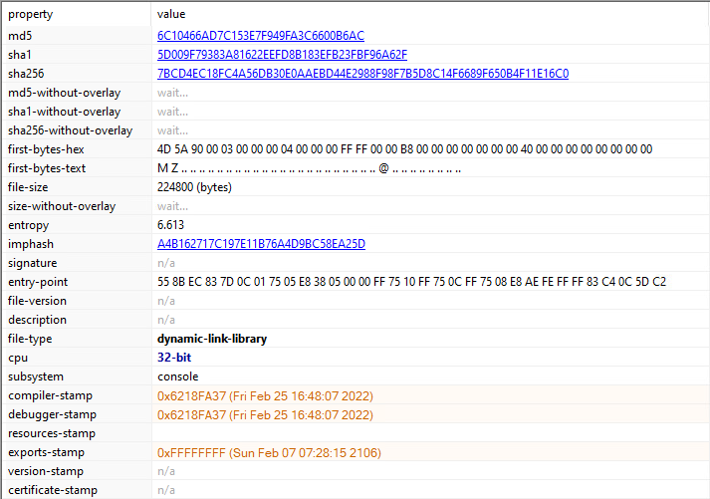
ISAACWiper Static Analysis

Slide 24
ISAACWiper Static Analysis (Tools)
Tools used:
PE Studio
Detect it Easy (DiE)
RDG Packer Detector
Professional PE file Explorer (Puppy)
CAPA
IDA
Hatching Triage (Online Sandbox)
Many Microsoft documentation lookups ☺

Slide 25
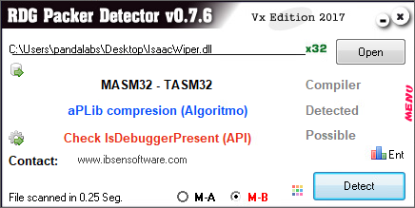
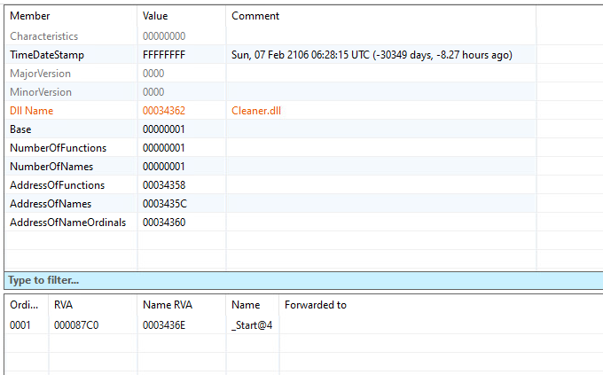
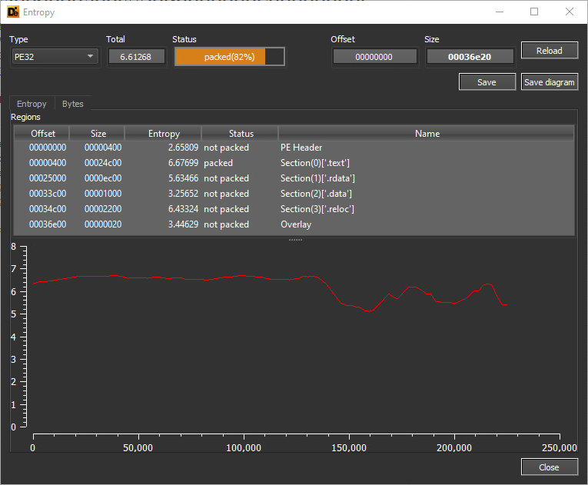
ISAACWiper Static Analysis

Slide 26
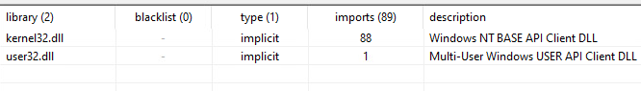
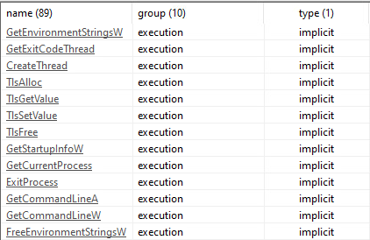
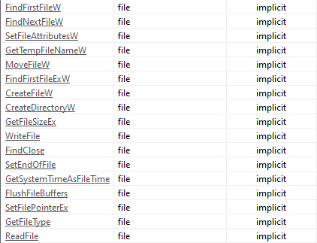
ISAACWiper Static Analysis (Libraries)
Libraries
Execution
File

Slide 27
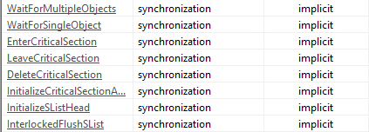
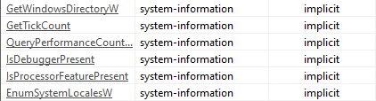
ISAACWiper Static Analysis (Libraries)
Synchronization
System-Information
Storage

Slide 28
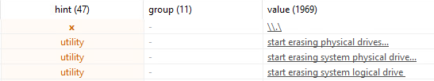
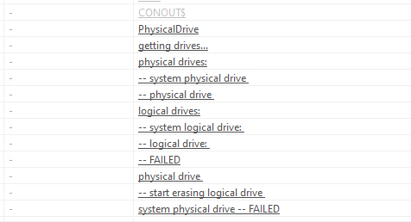
ISAACWiper Static Analysis (Strings)

Slide 29
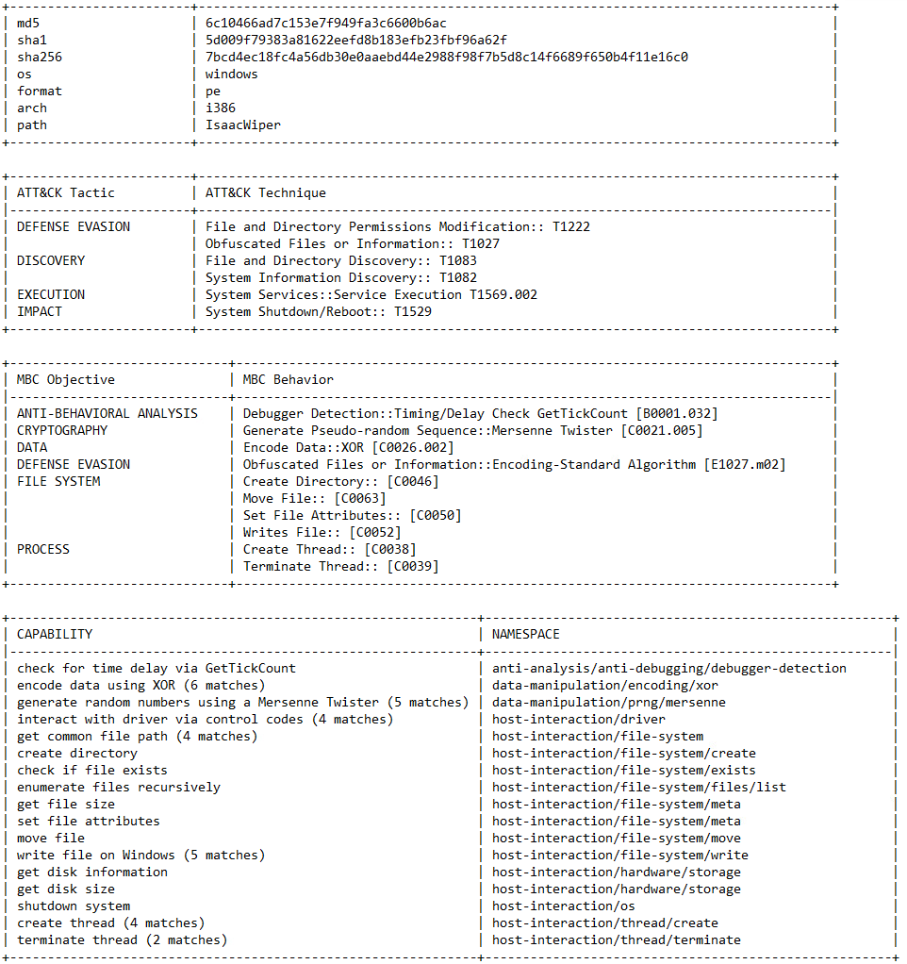
ISAACWiper Static Analysis (CAPA)

Slide 30
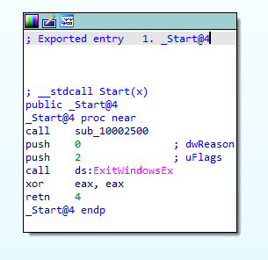
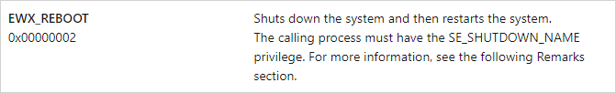
Reversing ISAACWiper (_Start@4)
Call sub_10002500
Reboot
Reference: https://learn.microsoft.com/en-us/windows/win32/api/winuser/nf-winuser-exitwindowsex

Slide 31
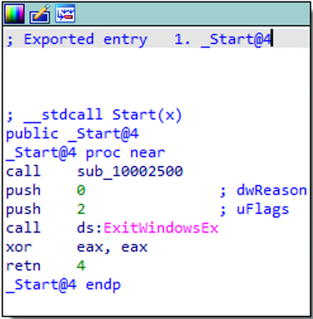
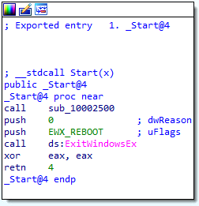
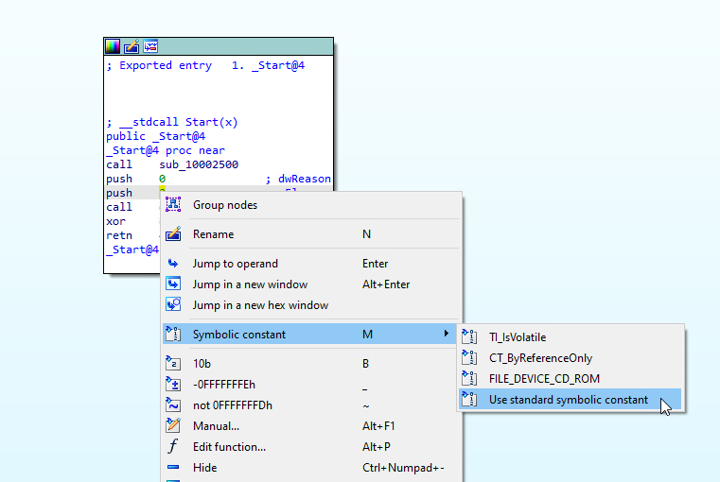
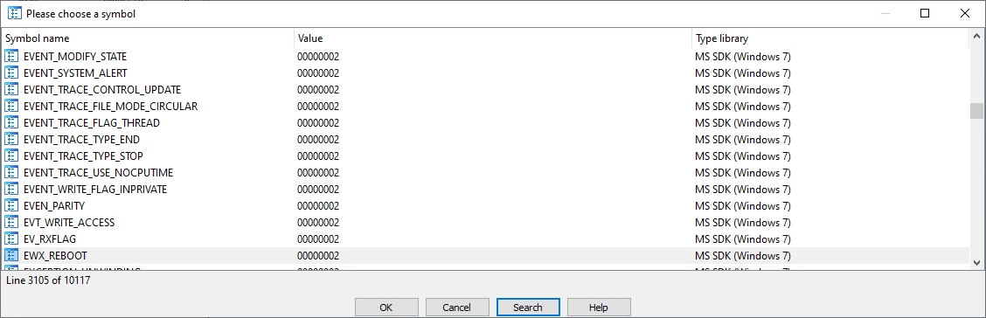
Reversing ISAACWiper (Symbolic Constants)

Slide 32
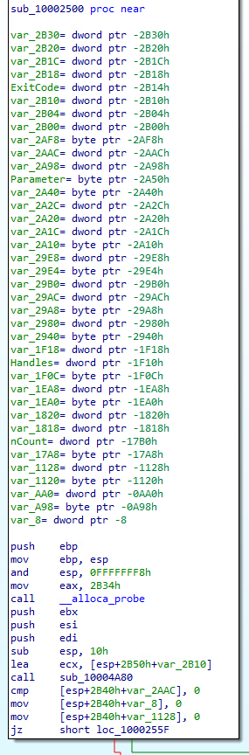
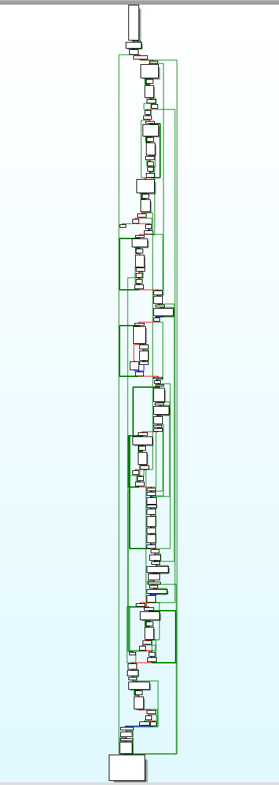
Reversing ISAACWiper (2500)

Slide 33
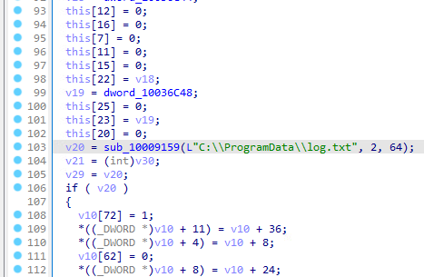
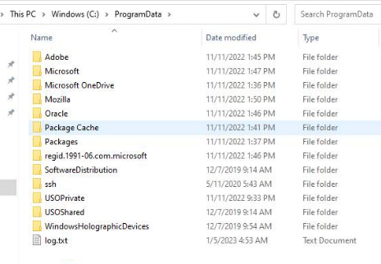
Reversing ISAACWiper (4A80)

Slide 34
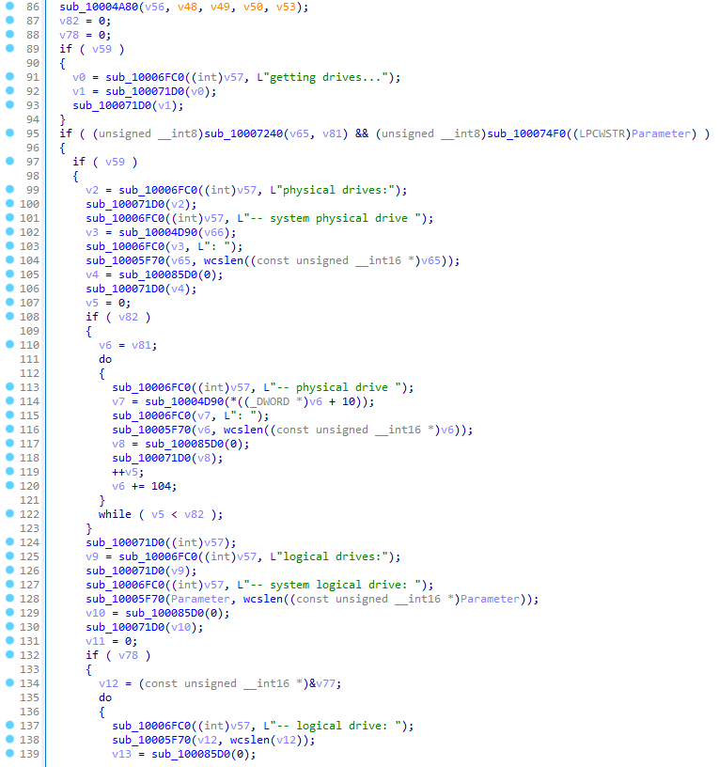
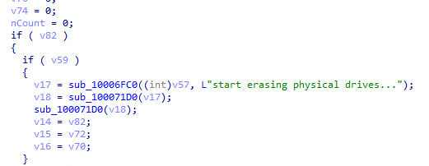
Reversing ISAACWiper (2500 DBG Strings)
Create log.txt

Slide 35
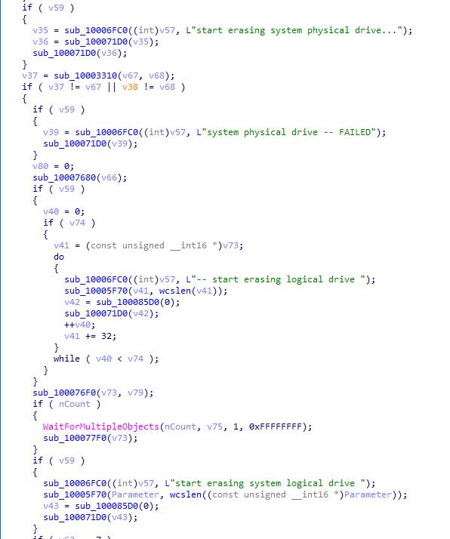
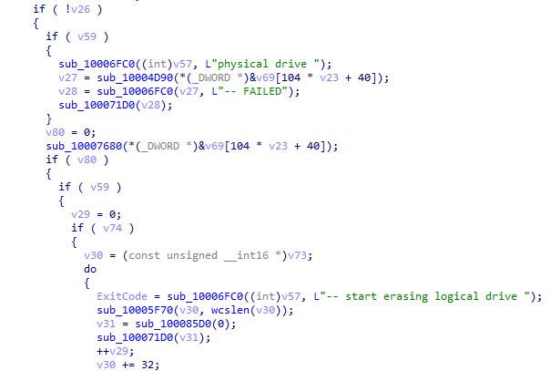
Reversing ISAACWiper (2500 DBG Strings 2)

Slide 36
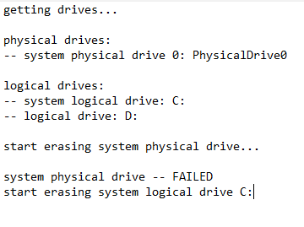
Reversing ISAACWiper (log.txt)

Slide 37
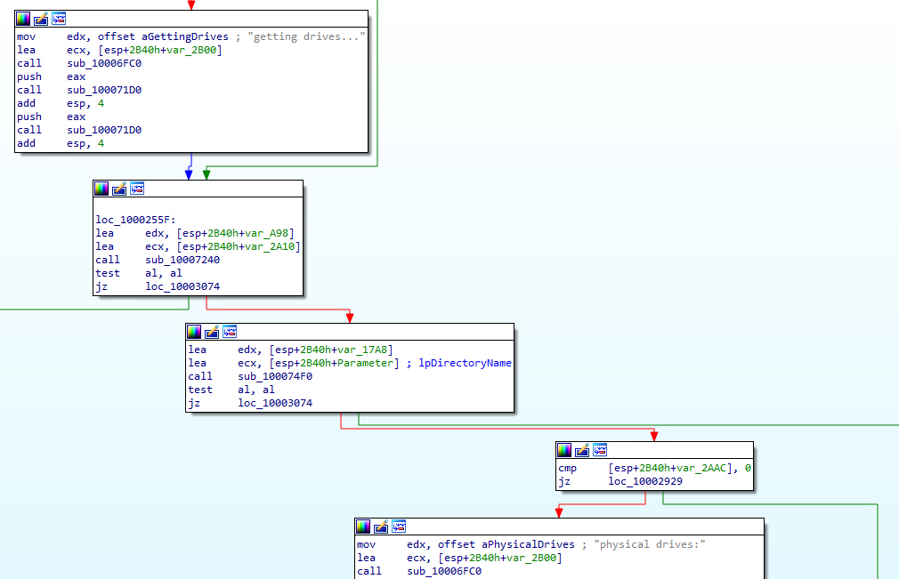
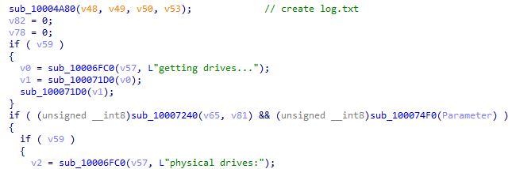
Reversing ISAACWiper (7240-74F0 Conditionals)

Slide 38
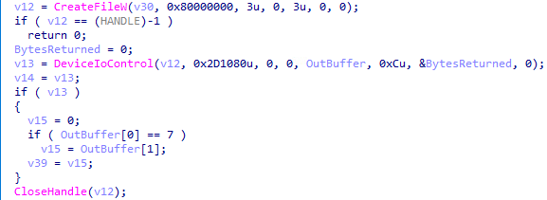
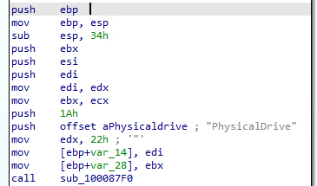


Reversing ISAACWiper (7240)
Get the list of physical drives (0-n)
dwIoControlCode
Reference: https://learn.microsoft.com/en-us/windows-hardware/drivers/kernel/specifying-device-types
Reference: https://learn.microsoft.com/en-us/windows-hardware/drivers/ddi/wdm/ns-wdm-_device_object
Reference: https://learn.microsoft.com/en-us/windows-hardware/drivers/ddi/ntddstor/ni-ntddstor-ioctl_storage_get_device_number

Slide 39

Reversing ISAACWiper (7240: DeviceIoControl)
Reference: https://learn.microsoft.com/en-us/windows/win32/api/ioapiset/nf-ioapiset-deviceiocontrol

Slide 40


Reversing ISAACWiper (7240 cont.)
Reference: https://learn.microsoft.com/en-us/windows/win32/api/fileapi/nf-fileapi-getdiskfreespaceexw

Slide 41


Reversing ISAACWiper (74F0)
Get partition of physical drive (n)
Reference: https://learn.microsoft.com/en-us/windows/win32/api/winioctl/ni-winioctl-ioctl_disk_get_drive_geometry_ex

Slide 42


ISAACWiper Wiping Operations (3310)
Reference: https://learn.microsoft.com/en-us/windows/win32/api/winioctl/ni-winioctl-fsctl_lock_volume

Slide 43



ISAACWiper Wiping Operations (3310 cont.)
Python “twist” implementation
Pseudocode “twist” implementation
Reference: https://blog.ollien.com/posts/reverse-mersenne-twister/
Reference: https://github.com/python/cpython/blob/main/Modules/_randommodule.c#L25

Slide 44


ISAACWiper Wiping Operations (3310 cont.)

Slide 45

ISAACWiper Wiping Operations (2500 cont.)

Slide 46

ISAACWiper Wiping Operations (39F0)
Mersenne Twister Algorithm

Slide 47



ISAACWiper Wiping Operations (GetTempFileNameW)
GetTempFileNameW(“.”, ”Tmf”, TickCount, “.”)
Reference: https://learn.microsoft.com/en-us/windows/win32/api/fileapi/nf-fileapi-gettempfilenamea

Slide 48



ISAACWiper Wiping Operations (3700)
Sub_10003560

Slide 49

ISAACWiper Execution

Slide 50




ISAACWiper Execution cont.

Slide 51
ISAACWiper Recap
Start
Create log.txt
Get physical drives
Get partitions and drive data
Overwrite physical drives with 10k bytes of PRNG data
Using 1 thread, create a file named “TmdXXXX/TmfXXXX.tmp and write to it using PRNG data until disk is full
End
Recursively wipe first 10k bytes of all files with PRNG data

Slide 52

ISAACWiper
MersenneTwisterWiper

Slide 53

YARA Signature (ISAACWiper)

Slide 54
Technical Analysis (Azov Ransomware)

Slide 55


Found in wild
Notes:
The Man Who Found Stuxnet – Sergey Ulasen
Blue screen of death
#https://www.youtube.com/watch?v=U_7CGl6VWaQ
#https://eugene.kaspersky.com/2011/11/02/the-man-who-found-stuxnet-sergey-ulasen-in-the-spotlight/
#https://www.wilderssecurity.com/threads/rootkit-tmphider.276994/#post-1712134

Slide 56


Looking into it

Slide 57

What it do?

Slide 58


RansomWare Note

Slide 59


What it do

Slide 60
What is AZOV RANSOMWARE?
Virus
Backdoor
Dropper
Wiper
Logic Bomb
Polymorphic
Malware
Ransomware
Using anti-analysis and code obfuscation techniques
Multi-threaded intermittent Wiper
Polymorphic way of backdooring 64-bit “.exe” files across the compromised system
“logic bomb” set to detonate at a certain time. The sample analyzed below was set to detonate at 10-27-2022 10:14:30 AM UTC
No network activity and no data exfiltration
Effective, fast, and unfortunately unrecoverable data wiper

Slide 61

Driver(main function)

Slide 62

Decrypt Shell code

Slide 63

Python Script to decrypt Shell code

Slide 64

Anti-Analysis Technique

Slide 65


Obfuscation used

Slide 66


Persistence and trigger

Slide 67

Create Filter out files with extentions

Slide 68


Creating Mutex

Slide 69

Wiping Module

Slide 70

Drop of backdoor

Slide 71

Drop of backdoor

Slide 72




Yara Signature

Slide 73

VirusTotal Query (Azov)
VirusTotal query – Azov-related samples
(behaviour:'Local\\\\Kasimir_*’
OR behaviour:'Local\\\\azov’)
AND
(behaviour_files:'RESTORE_FILES’
OR behaviour_registry:'rdpclient.exe’)

Slide 74
Postmortem and Recommendations

Slide 75
The Cost of Cyberwarfare
Ukrainian President Volodymyr Zelensky accused Russia of ‘energy terrorism’ and said that about 4.5 million Ukrainian consumers were temporarily disconnected from the power supply.
Also referred to the water shortages.
includes a hack, which the White House blamed on the Kremlin, that disrupted satellite internet communications in Ukraine on the eve of Russia’s invasion.
In 2017, NotPetya wiped computer systems at companies across Ukraine before spreading around the world; The incident cost the global economy billions of dollars by disrupting shipping giant Maersk and other multinational firms.
Groups are currently working on some high-complexity attacks that we will observe later.

Slide 76
Recommendations for users & organizations
Know what your critical assets are and what software is running on them.
Keep your software up to date. Prioritize patching critical and high vulnerabilities that allow remote code execution.
Enforce Multifactor Authentication (MFA) to the greatest extent possible.
Require the use of a password manager to generate strong and unique passwords for each separate account.
Backup all the essential files on the cloud and external drives and regularly maintain them.
Train your employees to recognize phishing emails, suspicious websites, infected links or other abnormalities to prevent successful compromise of email accounts.

Slide 77
Sample Hashes (SHA256)
AcidRain: 9b4dfaca873961174ba935fddaf696145afe7bbf5734509f95feb54f3584fd9a
Azov Ransomware: b102ed1018de0b7faea37ca86f27ba3025c0c70f28417ac3e9ef09d32617f801 650f0d694c0928d88aeeed649cf629fc8a7bec604563bca716b1688227e0cc7e
CaddyWiper: a294620543334a721a2ae8eaaf9680a0786f4b9a216d75b55cfd28f39e9430ea
7f76e7a9e784b90463a67ad40b1acf68c6e706fe489f82058ae608dbc203f832
CryWiper:
bdf8b53d73ca1ed1b649b32a61608b2cf952397ef3d5fc2e6e9f41ad98c40110
DesertBlade: a196c6b8ffcb97ffb276d04f354696e2391311db3841ae16c8c9f56f36a38e92 dcbbae5a1c61dbbbb7dcd6dc5dd1eb1169f5329958d38b58c3fd9384081c9b78
dnWipe:
610ec163e7b34abd5587616db8dac7e34b1aef68d0260510854d6b3912fb0008
DoubleZero: 3b2e708eaa4744c76a633391cf2c983f4a098b46436525619e5ea44e105355fe 30b3cbe8817ed75d8221059e4be35d5624bd6b5dc921d4991a7adc4c3eb5de4a
HermeticWiper: 5a300f72e221a228e3a36a043bef878b570529a7abc15559513ea07ae280bb48 2d29f9ca1d9089ba0399661bb34ba2fd8aba117f04678cd71856d5894aa7150b a259e9b0acf375a8bef8dbc27a8a1996ee02a56889cba07ef58c49185ab033ec 1bc44eef75779e3ca1eefb8ff5a64807dbc942b1e4a2672d77b9f6928d292591 2c10b2ec0b995b88c27d141d6f7b14d6b8177c52818687e4ff8e6ecf53adf5bf 3c557727953a8f6b4788984464fb77741b821991acbf5e746aebdd02615b1767 0385eeab00e946a302b24a91dea4187c1210597b8e17cd9e2230450f5ece21da 06086c1da4590dcc7f1e10a6be3431e1166286a9e7761f2de9de79d7fda9c397 b6f2e008967c5527337448d768f2332d14b92de22a1279fd4d91000bb3d4a0fd fd7eacc2f87aceac865b0aa97a50503d44b799f27737e009f91f3c281233c17d b01e0c6ac0b8bcde145ab7b68cf246deea9402fa7ea3aede7105f7051fe240c1 e5f3ef69a534260e899a36cec459440dc572388defd8f1d98760d31c700f42d5 23ef301ddba39bb00f0819d2061c9c14d17dc30f780a945920a51bc3ba0198a4 2c7732da3dcfc82f60f063f2ec9fa09f9d38d5cfbe80c850ded44de43bdb666d 8c614cf476f871274aa06153224e8f7354bf5e23e6853358591bf35a381fb75b 96b77284744f8761c4f2558388e0aee2140618b484ff53fa8b222b340d2a9c84
IsaacWiper: 13037b749aa4b1eda538fda26d6ac41c8f7b1d02d83f47b0d187dd645154e033 7bcd4ec18fc4a56db30e0aaebd44e2988f98f7b5d8c14f6689f650b4f11e16c0 abf9adf2c2c21c1e8bd69975dfccb5ca53060d8e1e7271a5e9ef3b56a7e54d9f afe1f2768e57573757039a40ac40f3c7471bb084599613b3402b1e9958e0d27a
PartyTicket Ransomware: 4dc13bb83a16d4ff9865a51b3e4d24112327c526c1392e14d56f20d6f4eaf382
Nominatus_ToxicBattery:
45e433d6fd0710d2905f21fda25c02fccab9eef43732384f0f0ea65ee464b936
Prestige Ransomware: 5dd1ca0d471dee41eb3ea0b6ea117810f228354fc3b7b47400a812573d40d91d 5fc44c7342b84f50f24758e39c8848b2f0991e8817ef5465844f5f2ff6085a57 6cff0bbd62efe99f381e5cc0c4182b0fb7a9a34e4be9ce68ee6b0d0ea3eee39c
RansomBoggs: 78dcf144e82e947c20f152a8a57376b43e7aac3fee4bf1d18d22d4c14b25e56f
a490d03e780a6b664da65e20afa7845c6f79af60b6a496ff113bf9e9034e77d0
RU_Ransom: 107da216ad99b7c0171745fe7f826e51b27b1812d435b55c3ddb801e23137d8f 1f36898228197ee30c7b0ec0e48e804caa6edec33e3a91eeaf7aa2c5bbb9c6e0 610ec163e7b34abd5587616db8dac7e34b1aef68d0260510854d6b3912fb0008 696b6b9f43e53387f7cef14c5da9b6c02b6bf4095849885d36479f8996e7e473 8f2ea18ed82085574888a03547a020b7009e05ae0ecbf4e9e0b8fe8502059aae 979f9d1e019d9172af73428a1b3cbdff8aec8fdbe0f67cba48971a36f5001da9
Somnia Ransomware: 100c5e4d5b7e468f1f16b22c05b2ff1cfaa02eafa07447c7d83e2983e42647f0 ac5e68c15f5094cc6efb8d25e1b2eb13d1b38b104f31e1c76ce472537d715e08 156965227cbeeb0e387cb83adb93ccb3225f598136a43f7f60974591c12fafcf e449c28e658bafb7e32c89b07ddee36cadeddfc77f17dd1be801b134a6857aa9
WhisperGate: a196c6b8ffcb97ffb276d04f354696e2391311db3841ae16c8c9f56f36a38e92 44ffe353e01d6b894dc7ebe686791aa87fc9c7fd88535acc274f61c2cf74f5b8 dcbbae5a1c61dbbbb7dcd6dc5dd1eb1169f5329958d38b58c3fd9384081c9b78
Industroyer2:
d69665f56ddef7ad4e71971f06432e59f1510a7194386e5f0e8926aea7b88e00
AwfulShred: bcdf0bd8142a4828c61e775686c9892d89893ed0f5093bdc70bde3e48d04ab99
OrcShred: NONE
SoloShred: NONE

Slide 78
References
https://arstechnica.com/information-technology/2022/12/never-before-seen-malware-is-nuking-data-in-russias-courts-and-mayors-offices/
https://avertium.com/blog/hermeticwizard-hermeticransom-isaacwiper-target-ukraine
https://bitdefender.com/blog/hotforsecurity/russian-courts-attacked-by-crywiper-malware-that-poses-as-ransomware/
https://bleepingcomputer.com/news/security/ukraine-says-russian-hacktivists-use-new-somnia-ransomware/
https://blog.checkpoint.com/2022/12/12/from-disruption-to-destruction-azov-ransomware-presents-a-new-shift-towards-destructive-wipers/
https://blog.ollien.com/posts/reverse-mersenne-twister/
https://blogs.vmware.com/security/2022/04/ruransom-a-retaliatory-wiper.html
https://cert.gov.ua/article/2724253
https://cert.gov.ua/article/38088
https://cert.gov.ua/article/39518
https://cisa.gov/uscert/ncas/analysis-reports/ar22-115b
https://crowdstrike.com/blog/how-to-decrypt-the-partyticket-ransomware-targeting-ukraine/
https://crowdstrike.com/blog/technical-analysis-of-whispergate-malware/
https://crowdstrike.com/blog/the-anatomy-of-wiper-malware-part-1/
https://crowdstrike.com/blog/the-anatomy-of-wiper-malware-part-2/
https://crowdstrike.com/blog/the-anatomy-of-wiper-malware-part-3/
https://crowdstrike.com/blog/the-anatomy-of-wiper-malware-part-4/
https://csis.org/analysis/cyber-war-and-ukraine
https://cyberconflicts.cyberpeaceinstitute.org/threats
https://cyberconflicts.cyberpeaceinstitute.org/threats/attack-details
https://cyberpeaceinstitute.org/ukraine-timeline-of-cyberattacks/
https://cyfirma.com/outofband/prestige-ransomware-analysis/
https://esentire.com/blog/esentire-threat-intelligence-malware-analysis-caddywiper
https://europarl.europa.eu/RegData/etudes/BRIE/2022/733549/EPRS_BRI(2022)733549_EN.pdf
https://fortinet.com/blog/threat-research/the-increasing-wiper-malware-threat
https://github.com/eset/malware-ioc/tree/master/ua_wipers
https://github.com/python/cpython/blob/main/Modules/_randommodule.c#L25
https://i.blackhat.com/USA-22/Wednesday/US-22-Cherepanov-Industroyer2-Sandworms-Cyberwarfare-Targets-Ukraines-Power-Grid-Again.pdf

Slide 79
References
https://iisf.ie/wiper-malware
https://inquest.net/blog/2022/04/07/ukraine-cyberwar-overview
https://learn.microsoft.com/en-us/windows-hardware/drivers/ddi/ntddstor/ni-ntddstor-ioctl_storage_get_device_number
https://learn.microsoft.com/en-us/windows-hardware/drivers/ddi/wdm/ns-wdm-_device_object
https://learn.microsoft.com/en-us/windows-hardware/drivers/kernel/specifying-device-types
https://learn.microsoft.com/en-us/windows/win32/api/fileapi/nf-fileapi-getdiskfreespaceexw
https://learn.microsoft.com/en-us/windows/win32/api/ioapiset/nf-ioapiset-deviceiocontrol
https://learn.microsoft.com/en-us/windows/win32/api/winioctl/ni-winioctl-fsctl_lock_volume
https://learn.microsoft.com/en-us/windows/win32/api/winioctl/ni-winioctl-ioctl_disk_get_drive_geometry_ex
https://learn.microsoft.com/en-us/windows/win32/api/winuser/nf-winuser-exitwindowsex
https://microsoft.com/en-us/security/blog/2022/10/14/new-prestige-ransomware-impacts-organizations-in-ukraine-and-poland/
https://msrc-blog.microsoft.com/2022/02/28/analysis-resources-cyber-threat-activity-ukraine/
https://politico.com/news/2022/12/07/estonia-ukraine-cybersecurity-russian-hackers-00072925
https://query.prod.cms.rt.microsoft.com/cms/api/am/binary/RE4Vwwd
https://research.checkpoint.com/2022/pulling-the-curtains-on-azov-ransomware-not-a-skidsware-but-polymorphic-wiper/
https://sentinelone.com/labs/acidrain-a-modem-wiper-rains-down-on-europe/
https://sentinelone.com/labs/hermetic-wiper-ukraine-under-attack/
https://splunk.com/en_us/blog/security/threat-update-doublezero-destructor.html
https://techtarget.com/searchsecurity/news/252528410/Check-Point-classifies-Azov-as-wiper-not-ransomware
https://trellix.com/en-us/about/newsroom/stories/research/wipermania-an-all-you-can-wipe-buffet.html
https://trendmicro.com/en_us/research/22/c/cyberattacks-are-prominent-in-the-russia-ukraine-conflict.html
https://trendmicro.com/en_us/research/22/c/new-ruransom-wiper-targets-russia.html
https://trustwave.com/en-us/resources/blogs/spiderlabs-blog/overview-of-the-cyber-weapons-used-in-the-ukraine-russia-war/
https://twitter.com/struppigel/status/1501473254787198977
https://unit42.paloaltonetworks.com/doublezero-net-wiper/
https://welivesecurity.com/2022/02/24/hermeticwiper-new-data-wiping-malware-hits-ukraine/
https://welivesecurity.com/2022/03/01/isaacwiper-hermeticwizard-wiper-worm-targeting-ukraine/
https://welivesecurity.com/2022/04/12/industroyer2-industroyer-reloaded/
https://zscaler.com/blogs/security-research/technical-analysis-partyticket-ransomware

Slide 80
Thank you!
https://github.com/ryanestes/CyberwarfarePresentation
Open for Q&A
Ashu.Sharma@watchguard.com
Ryan.Estes@watchguard.com

